Slide 1


Sentiment Analysis and Model comparison with mlpack c++
By John Kelechukwu Obi 20140237
Supervisor
Asst. Prof. Dr. Cem Kalyoncu

Slide 2
Table of contents
01
02
03
04
Introduction
Goals
Similar applications
Software and Tools used

Slide 3
Table of contents
05
07
06
Methodology
Results and conclusions
Courses used

Slide 4
01
Introduction

Slide 5
Introduction: aim
The aim is to address the challenge of analysing the sentiment in text data. Sentiment analysis involves determining the emotional tone expressed in a piece of text, classifying it as positive or negative. This is crucial for understanding user and public opinions, customer feedback and social media sentiment.
Where the problem lies is in accurately categorizing diverse textual inputs which may contain subtle nuances and context-dependent sentiments. The challenge is to develop a robust system that can with less issues discern sentiments effectively and provide valuable insights into the emotional tone of the text. Large text volumes are time consuming to analysis and very easily prone to bias.

Slide 6
02
Goals

Slide 7
Goals:
Real time usage
Cost reduction
User friendliness
The ability to perform or provide real time sentiment analysis and text classification. Crucial for social media apps and business apps where users feedback is valuable as quick as possible
Just taking the traditional way into consideration, the act of storing bad words and iterating through the rows word for word to compare is too time and resource consuming and not cost efficient. This project goal is to minimize such cost
Utilize dynamic HTML content to create an expressive and intuitive frontend experience that is easy for developers and end users to utilize

Slide 8
Goals:
API endpoints
Data storage
Data retrieval
To create a robust backend to handle Api endpoints for data collection and model interaction and database updates. Enables seamless communication between the frontend and the models
Integrate a database, in the system with the use PostgreSQL to store and manage textual data and model predictions.
Integrate a database inorder to obtain additional information for historical tracking, data analysis and retrieval

Slide 9
03
Similar real world applications

Slide 10
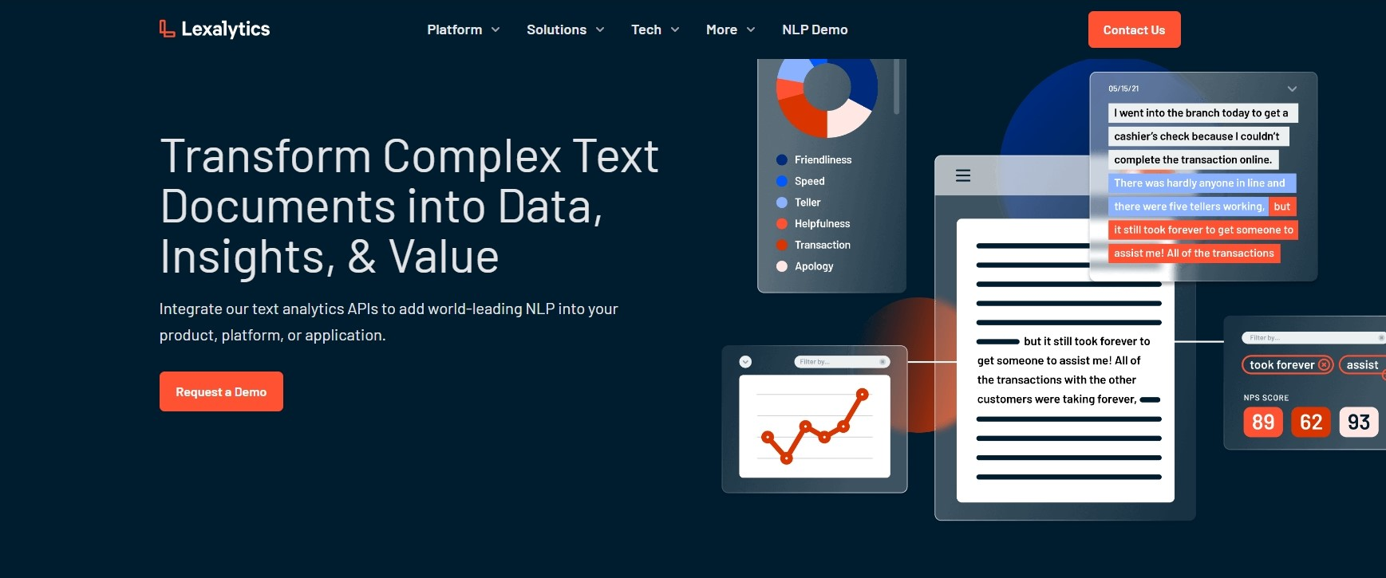
Lexalytics

Slide 11

Qualtrics

Slide 12
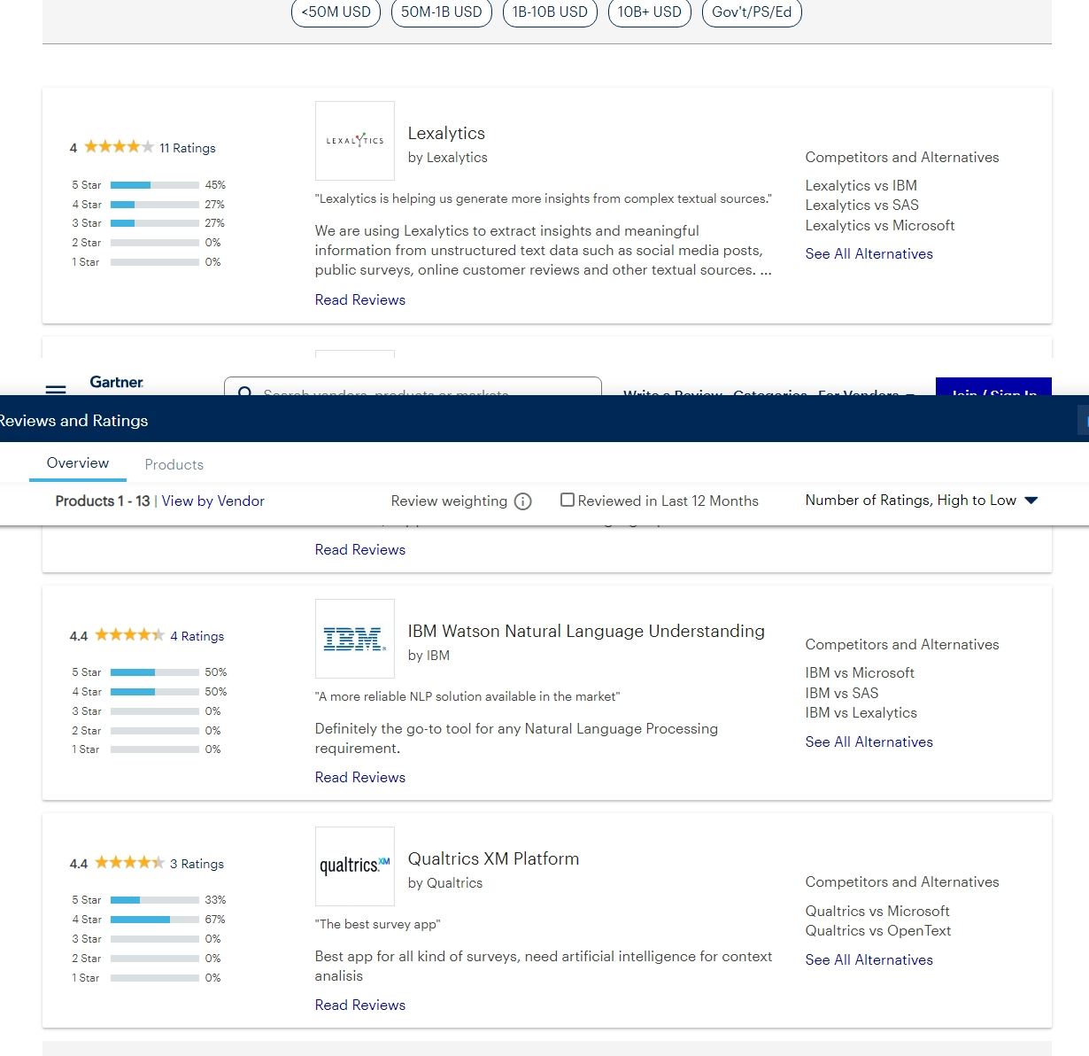
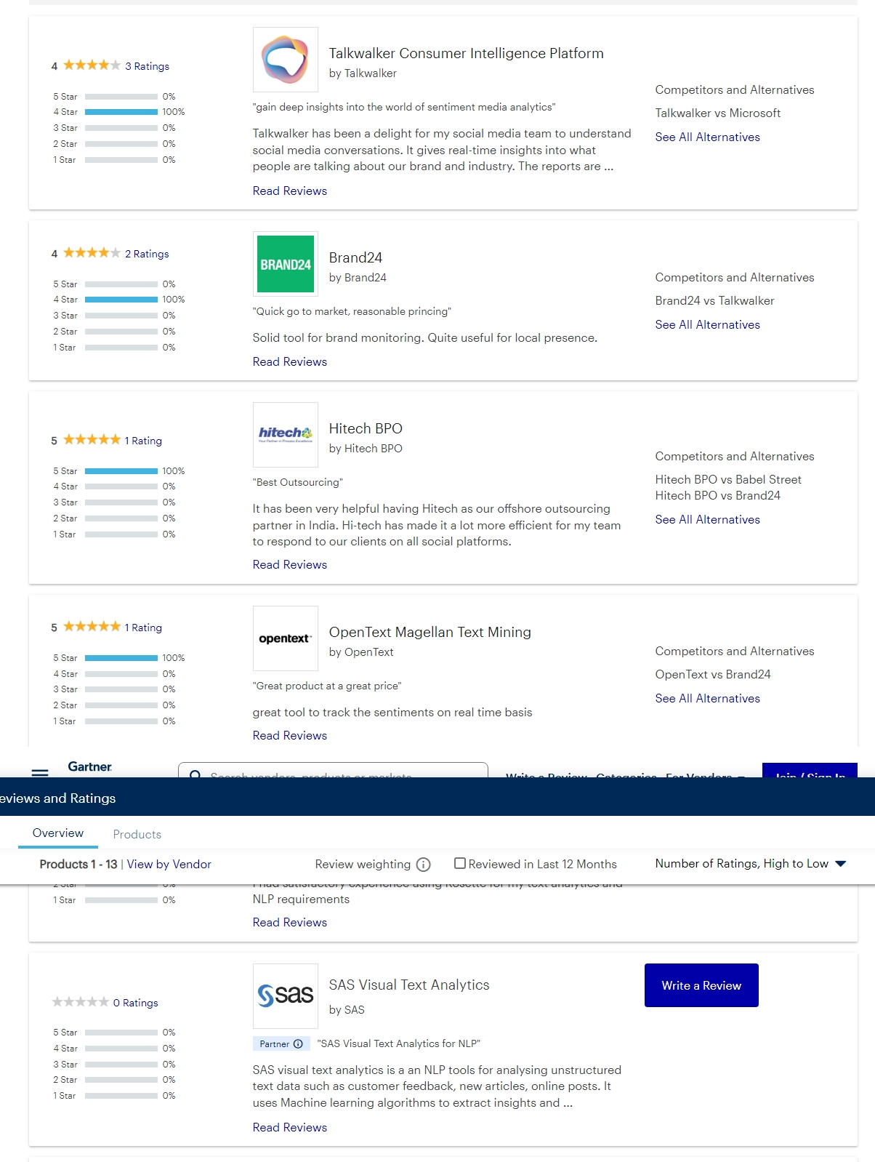

Slide 13

Software and tools used

Slide 14
Softwares;
Typescript/Javascript
A language for application-scale JavaScript and supports tools for JavaScript browser applications in large scale for any OS.
C++
It is a well-known robust, powerful and efficient language. İt was picked to be able to handle the real time analysis of the system with low latency
PostgreSQL
A robust modern database for the system. This database is picked due to the cloud hosting platform’s easy Postgres integration
Mlpack Library
A lightweight, fast, header-only library

Slide 15
Toolings;
uWebSockets
A C++ library that is lightweight and used for building real-time web servers with high performance and scalable solution. Its best features is been fast, easy to integrate into existing projects and memory efficient
Nholmann Json Library
Express.JS & EJS
Express.js; a JavaScript library for building backend servers and Api routes and capable of running in almost all JavaScript runtimes. Ejs; a JavaScript templating engine.
Cmake & vscode
A building system for C/C++ and code editor

Slide 16
05
Methodology

Slide 17
Methodology: model
Model development module
Cleaning & preprocessing
Modelling
Model serving
Json parsing, stemming, stop words removal, arbitrary character removal, thresholding, equalization, limit setting and feature extraction.
Single directory module for housing multiple models implementations
In Charge of hosting the built models to the public internet

Slide 18
Methodology: webserver
Webserver development
View module
routing
Database
The view module implements the user interface for end users to interact
Handles the network communication between the model server and the web server and acts as the middleman
Added and meant to store previous text classification and retrive them

Slide 19

06
Courses Used

Slide 20
Courses used;
Eul Courses
01 | COMP117 COMPUTING FOUNDATIONS | 08 | COMP337 DATABASE MANAGEMENT SYSTEMS
02 | COMP119 INTRODUCTION TO PROFESSION | 09 | COMP368 SOFTWARE ENGINEERING
03 | COMP124 COMPUTER PROGRAMMING | 10 | COMP464 INTERNET PROGRAMMING
04 | MATH109 LINEAR ALGEBRA | 11 | COMP448 ARTIFICAL NEURAL NETWORKS
05 | COMP217 DATA STRUCTURES | 12 | ENG434 ENGINERRING ETHICS
06 | COMP218 OBJECT ORIENTED PROGRAMMING I
07 | MATH226 PROBABILITY & STATISTICS METHODS

Slide 21
Web Server toolings percentage;
75%
50%
25%
HTML/EJS
Tailwind/CSS
TypeScript/JavaScript
This is entirely the huge portion of the web server, built with node.JS
Ejs renders the html content dynamically. The exact same way php does html content
A stylize ease use of styling and structuring the website

Slide 22
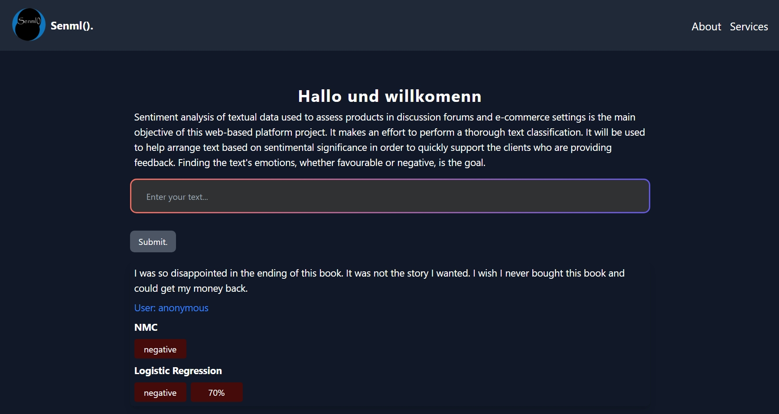
Computer View
The website is built with minimal frontend javascript and has alot of similarities with php rendering dynamic html content

Slide 23
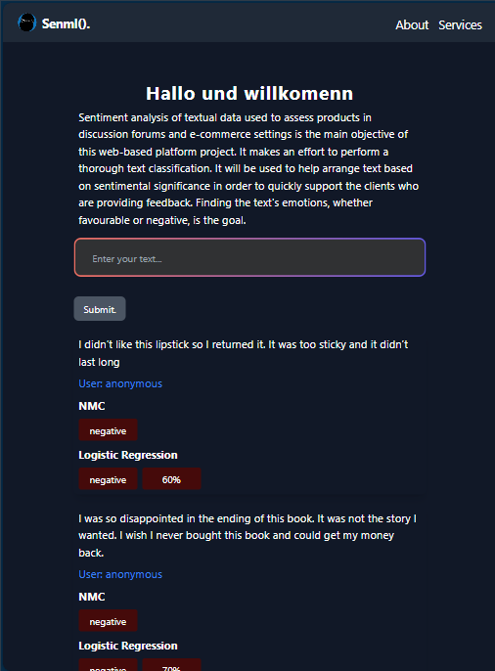
Tablet view
Tablet view is also quite good adding to its responsiveness

Slide 24
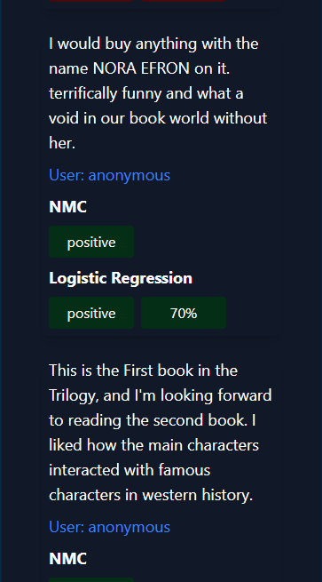
Mobile view
Due to not using modern frontend framework, the mobile view was really put in thought to optimize it.

Slide 25
Data Flow
Text from end users is submitted
Model server receives it, classify it and responds
Step 1
Step 3
Step 2
Step 4
Web server structure it for the model server
Web server receives response and the data in a structure the client view handles

Slide 26

—senml()
Results and conclusions

Slide 27
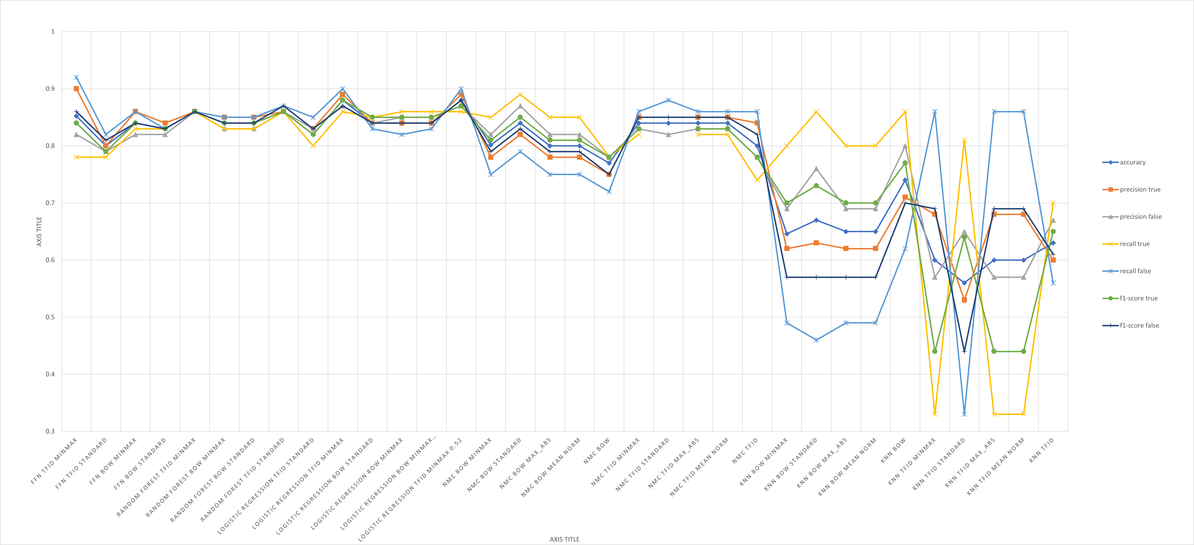
Results;

Slide 28
Thanks!
Feel free to reach me
johnobi2003@gmail.com
+90 533 826 5119
+234 8064137392
Service running on
senml-webserver.onrender.com

